Slide 1


Slide 2
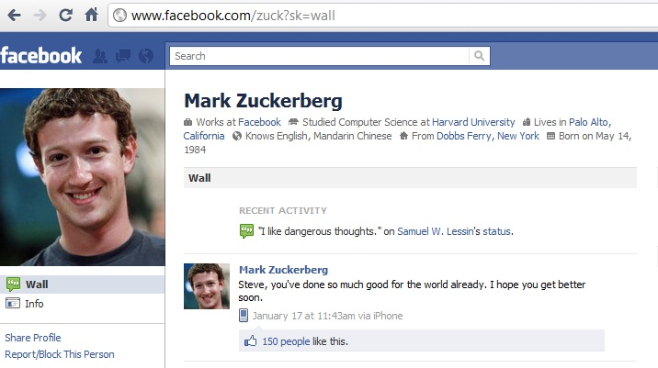



FRIENDS
FAVORITES

Slide 3



FRIENDS AND FAVORITES

Slide 4
Family

Slide 5
Mother and
Father

Slide 6
Brother and Sister

Slide 7
Classmates

Slide 8
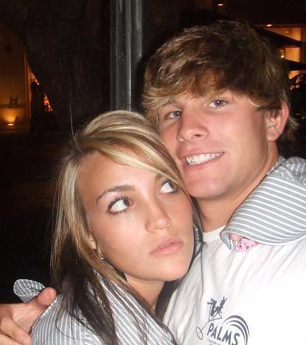
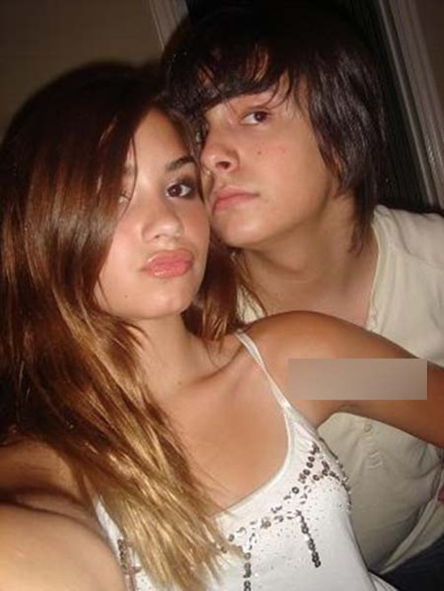
Girlfriend and boyfriend

Slide 9
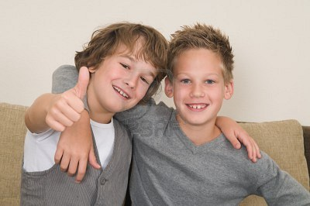
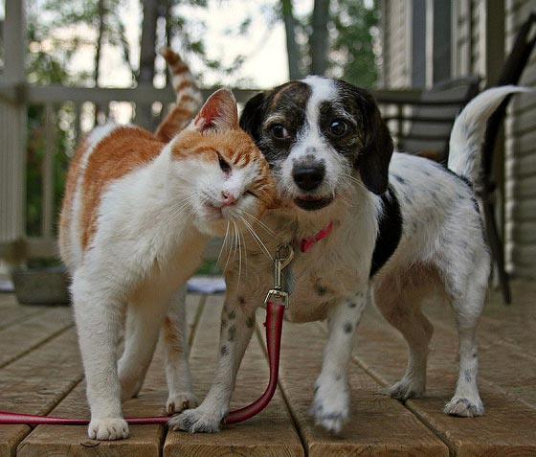
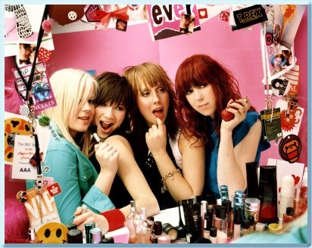
Best friends

Slide 10
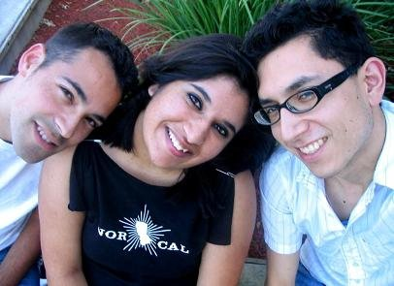
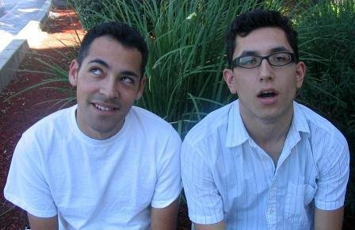
FRIENDS AND FAVORITES
I am friends with Osvy and Priyanka.
My best friend is Osvy.

Slide 11

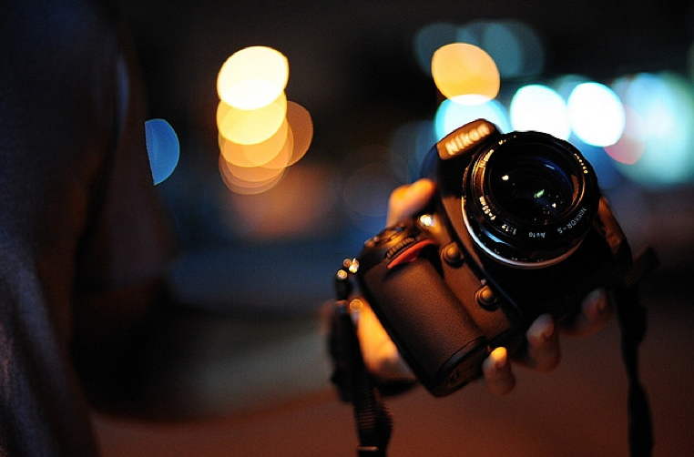
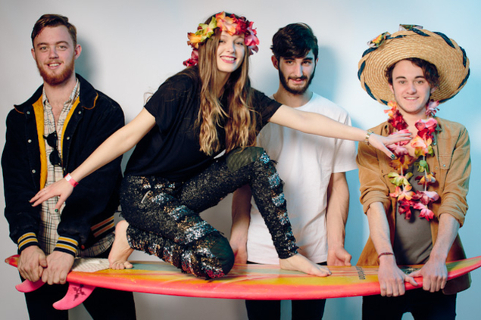
FRIENDS AND FAVORITES
I don´t have a favorite sport.
My favorite movie is The Hunger Games
But my favorite hobby is photography.
The Hunger Games is my favorite movie.
My favorite song is “Beach”.
“Beach” is my favorite song. https://www.youtube.com/watch?v=7pl2L-ldozI

Slide 12
QUESTIONS
Who are you friends with?
Who is your best friend?
What is your favorite sport?
What is your favorite movie?
What is your favorite song?
What is your favorite kind of music?

Slide 13
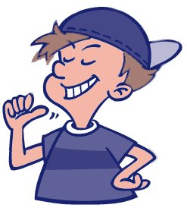
YES/NO QUESTIONS
He is a student.
Is he a teacher?
No, he isn´t. He is a student.

Slide 14
YES/NO QUESTIONS
He is …
Is he…?
She is …
Is she…?
It is …
Is it…?
I am …
Am I…?
You are …
Are you…?

Slide 15
SHORT ANSWERS
Yes, I am.
Yes, you are.
Yes, he is.
Yes, she is.
Yes, it is.
No, I am not.
No, you aren´t.
No, he isn´t.
No, she isn´t.
No, it isn´t.
No, I´m not.
No, you´re not.
No, he´s not.
No, she´s not.
No, it´s not.

Slide 16
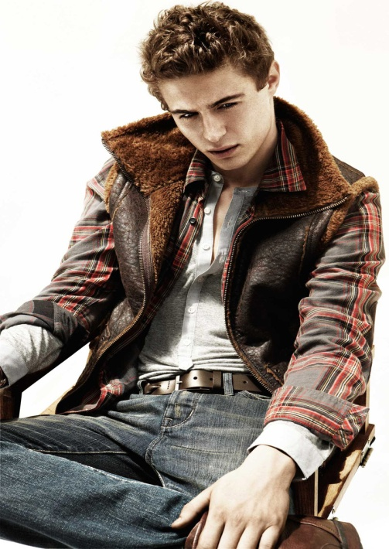
EXAMPLE
Are you a student?
No, I´m not.
I am an actor.
+
Short answer
Additional information

Slide 17
MY PROFILE
NAME:
_______________
CLASS:
_______________
My friends:
More about me:
Favorite sport _________
Favorite music _________
My best friend is ______.
My favorite sport is ______.
My favorite song is______
My favorite kind of music is ______
My name is ______ and my nickname is ______

Slide 18
QUESTIONS
Is _______ your best friend?
Is _______ your favorite sport?
Is _______ your favorite movie?
Is _______ your favorite song?
Is _______ your favorite actor/actress?
Is _______ your favorite kind of music?

Slide 19
MY PROFILE
1. My name is Jose and I don´t have a nickname.
2. My last name is Zegarra.
3. My favorite kinds of music are Indie, pop and electronic.
4. I don´t have a favorite sport, but my hobbie is photography.
5. My favorite song is “Rocket”
6. My favorite singer is Robyn.
7. My favorite movie is The Hunger Games.
8. My best friend is Jason.
9. His favorite movie is Gold Diggers of 1929.
10. His favorite sport is soccer.

Slide 20
MY PROFILE
Name
Nickname
Favorite sport
Favorite song
Favorite kind of music
Favorite actor
Favorite singer
Favorite sports player
Favorite TV show
Favorite movie
Favorite website
Friend / Best friend / Boyfriend / Girlfriend

Slide 21
MY PROFILE
Hi, my name is Chris and I don´t have a nickname. My last name is Quevedo. My favorite kinds of music are indie, pop and electronic. My favorite ………………… ……… ……… ………………………………… ……………………… ……………………………… ………………… …………………………………………………………………………………………………………………………………………………………………………………………. Well, this is me. ☺ Bye
Chris (your name)

